Slide 1

NYC Airbnb & Zillow Data Challenge
Most profitable Zip Codes for 2 Bedroom Properties
Photo: Getty Images

Slide 2


Introduction
A Real Estate Company wants to buy 2 Bedroom Properties in NYC for short term renting
Provide a data driven solution to help them understand which zip codes are most profitable

Slide 3
Data Source
Provides the Cost Data(monthly, from year 1997-2017), an estimate of value for two-bedroom properties
262 Variables, 8946 Observations
Provides the information about the rental properties on Airbnb
95 Variables, 40753 Observations

Slide 4
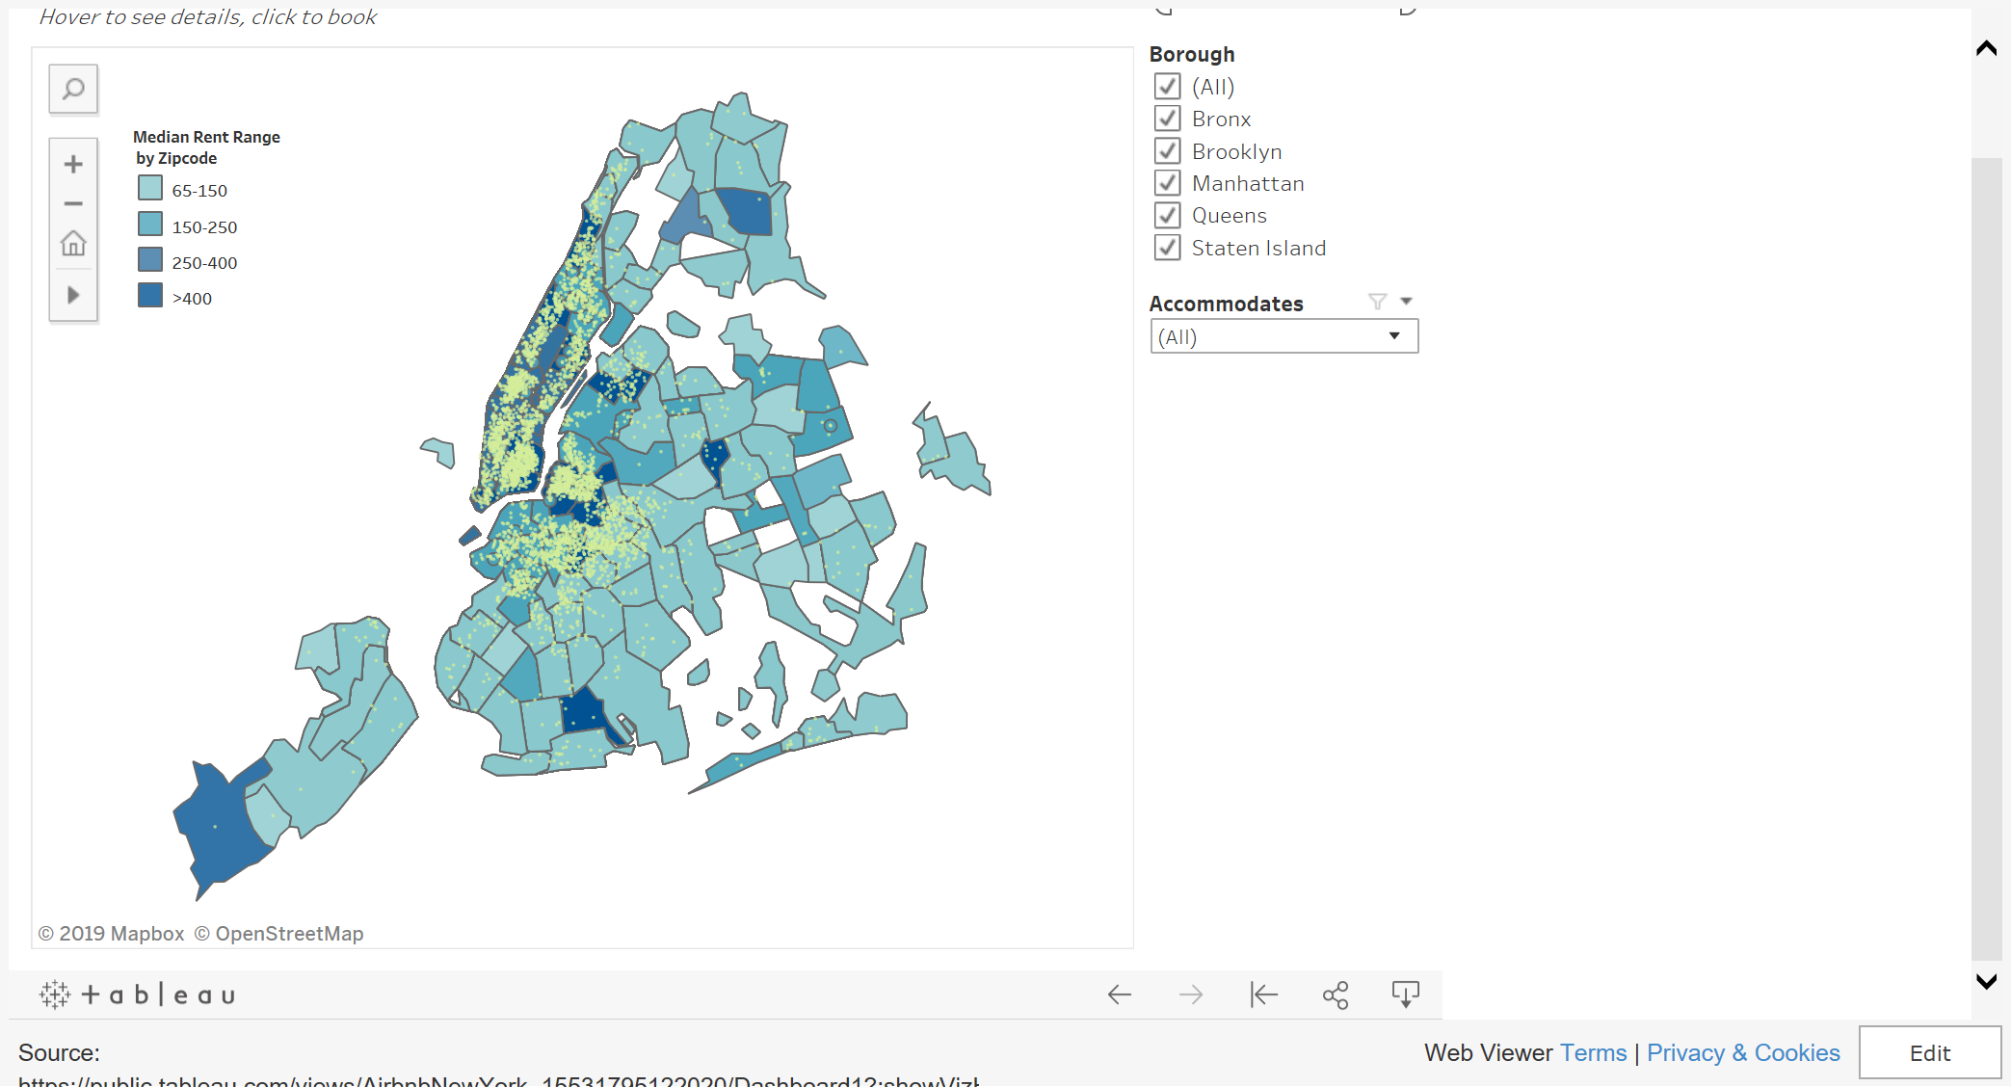
Where are the Airbnbs?

Slide 5
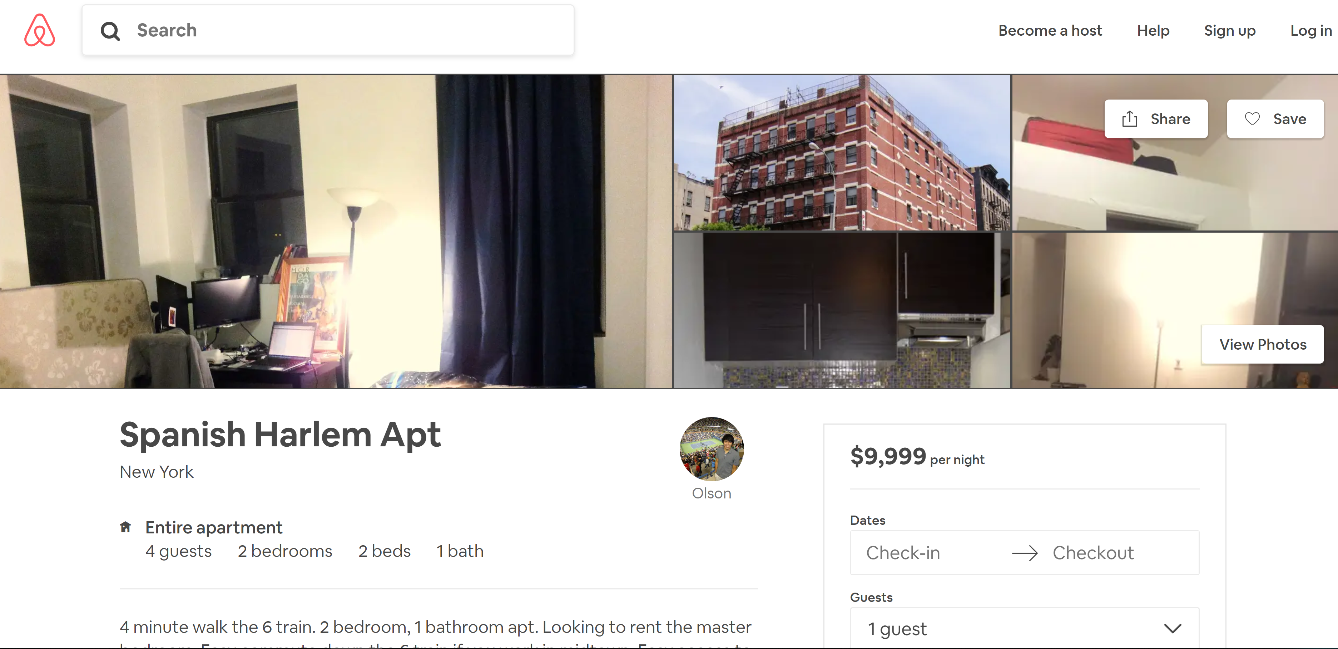
Most Expensive Rental?

Slide 6
Data Cleaning
Missing Values
Identify columns with missing values(square_feet, review_scores etc)
Rename and Drop
Columns
Give appropriate names to columns, drop irrelevant columns(State, City)
Format
Remove $ and – sings, convert data to appropriate types
Filter
Filter data to 2 Bedroom properties
Remove Outliers
Remove properties that have rental price > $2000

Slide 7
Summary Statistics
Important Variables
Zip code
Price Per Night
Number of Bedrooms
Boroughs of New York
Property Value for last 5 Years
Review Score for Location
Property Type(Apartment, House, Loft etc.)
Important Observations
Number of Observations – 1239
Number of Zip codes – 22
Zip code with most number of rental properties - 11211

Slide 8
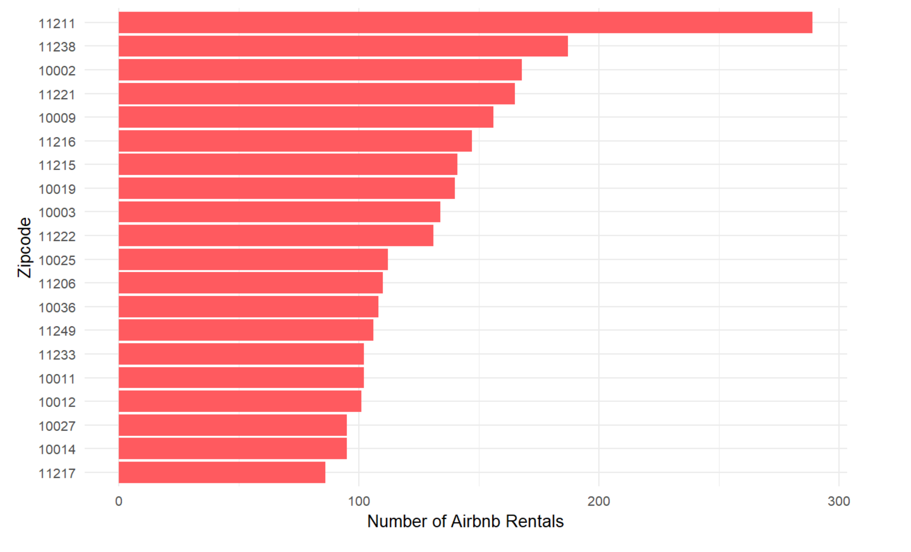
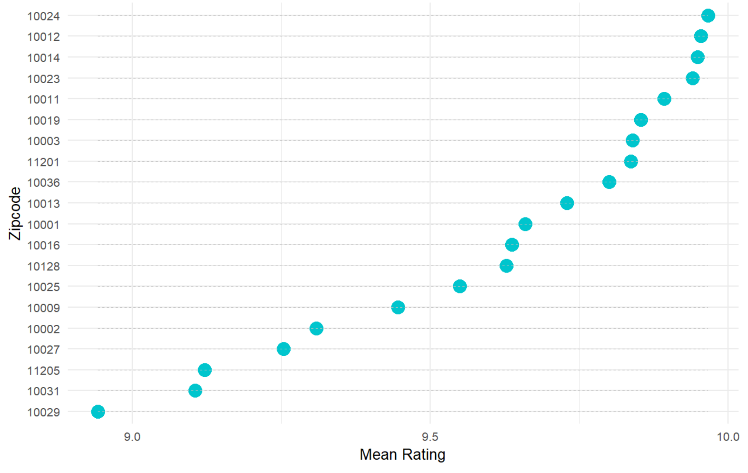
Most Popular Zipcodes
Number of Rental Properties
Mean Location Review

Slide 9
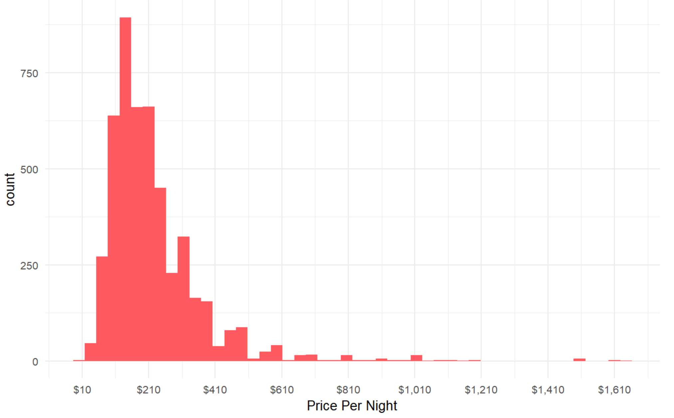
Analysis
Median Rental Price
Rental Price distribution is skewed.
Median Rental Price is calculated for each Zip code, used in further analysis.

Slide 10
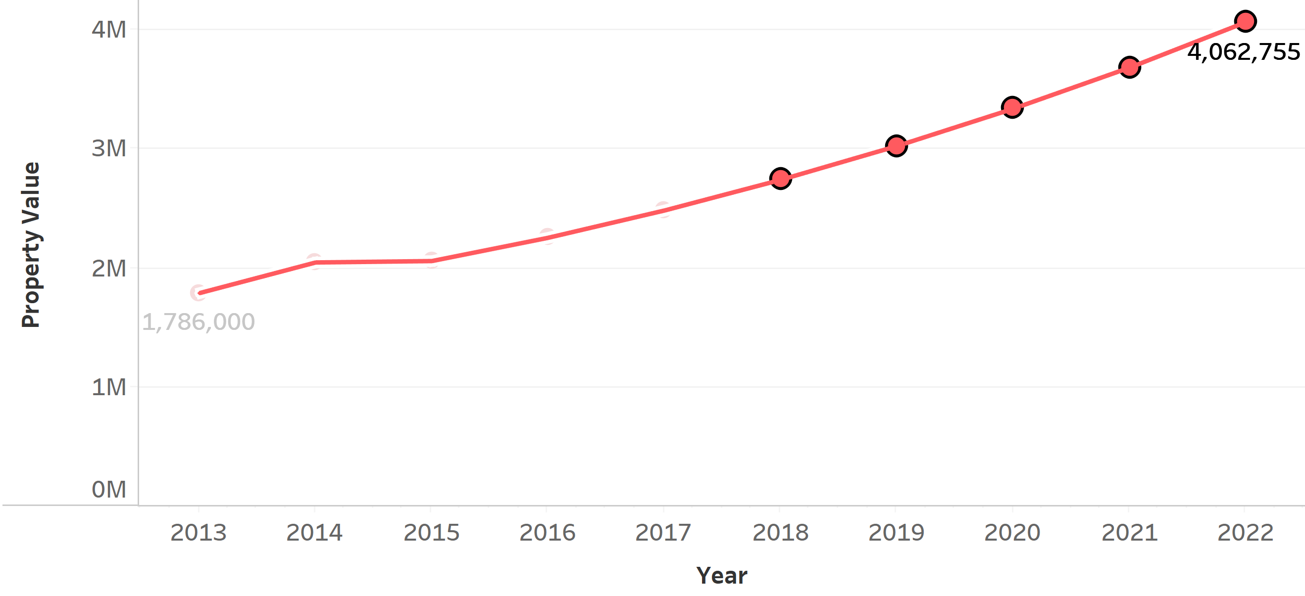
Analysis
Property Value Forecast for Zip code 10013
Forecasted Property Values
Using Average Year-on-Year growth for last 5 years, forecasted property values for next 5 years.
Property Values are forecasted on a Zip code level
Annual Revenue
Assuming 75% occupancy we calculate Annual Revenue for Zip code:
Annual Revenue = 0.75 * 365 * Median Rental Price

Slide 11
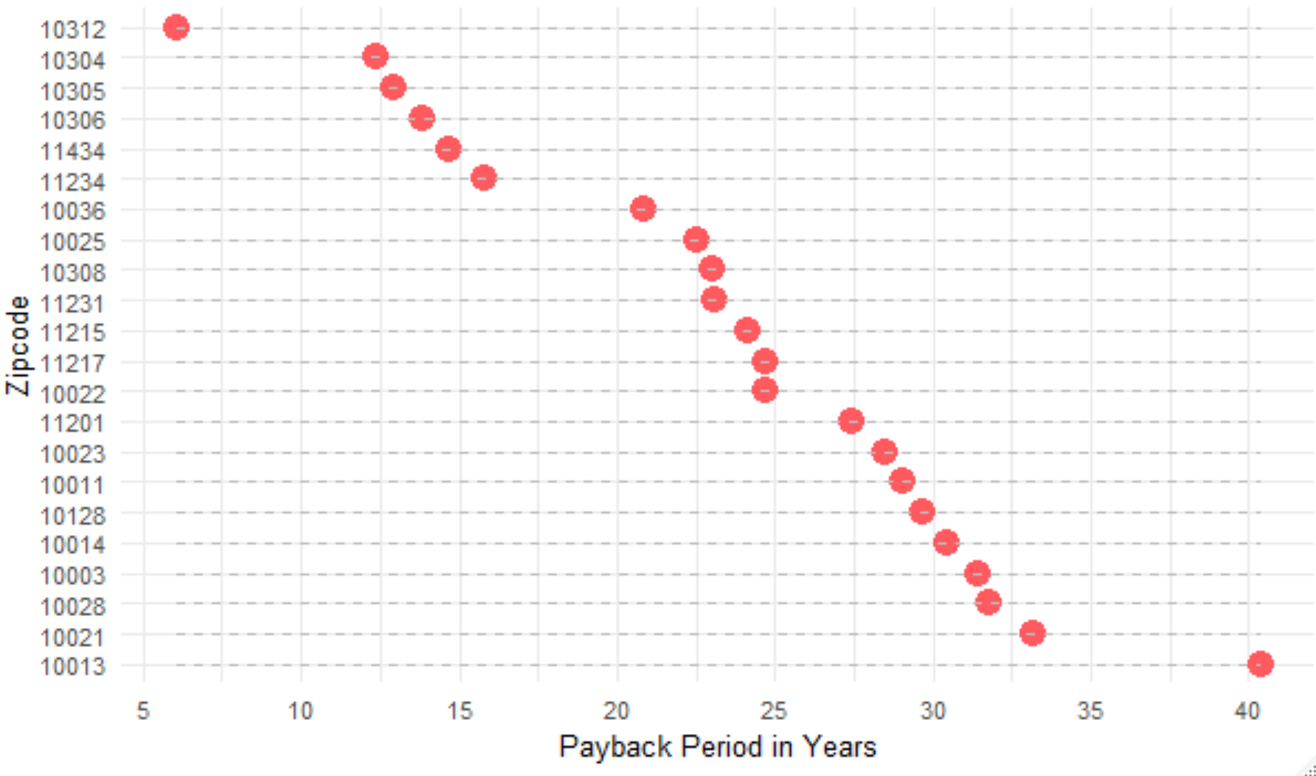
Analysis
Payback Period
Using Annual Revenue we calculate Payback Period for the initial investment for each Zip code

Slide 12
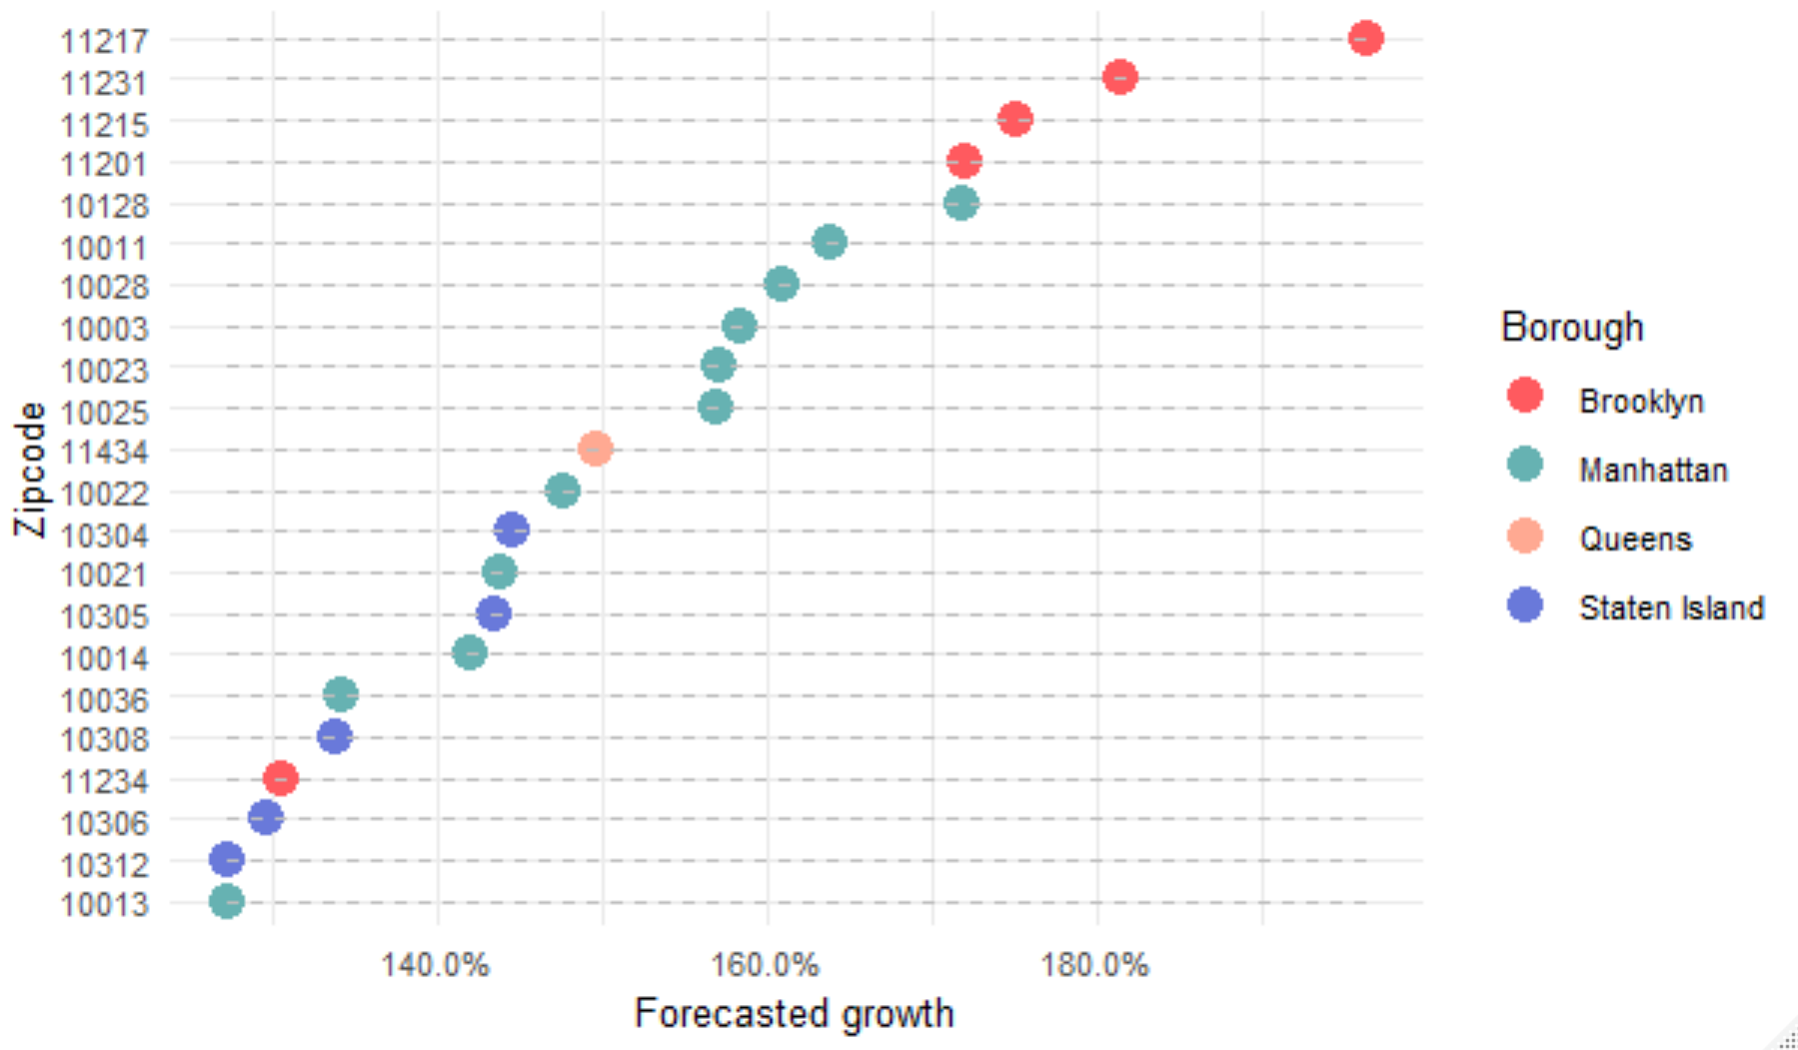
Analysis
Property Value Growth
Using the forecasted property values, calculated the growth in property values for each Zip code.

Slide 13
Recommendations
Criteria | Zipcodes
Based on number of Rental Properties in the area. | 11211, 11238, 10002
Based on Location Reviews | 10024, 10012, 10014
Property Value Growth | 11217, 11231, 11215
Payback Period | 10312, 10304, 10305

Slide 14


Thank You!

